Slide 1
Real-Time Translation Learning to Decode
Kyunghyun Cho
New York University
Courant Institute (Computer Science) and Center for Data Science
Facebook AI Research
Jiatao Gu, Victor Li, Graham Neubig, Kyunghyun Cho.
Learning to translate in real-time with neural machine translation. EACL’17.

Slide 2
Decoding from a recurrent language model

Slide 3
Decoding (0) – Exhaustive Search
Simple and exact decoding algorithm
Score each and every possible translation
Pick the best one

Slide 4
Decoding (1) – Ancestral Sampling
Efficient, unbiased sampling
One symbol at a time from
Until
The
cat
sat
…

Slide 5
Decoding (1) – Ancestral Sampling
Efficient, unbiased sampling
One symbol at a time from
Until
Repeat this procedure for times:
Choose
Pros:
Unbiased (asymptotically exact)
Cons:
High variance
Pretty inefficient

Slide 6
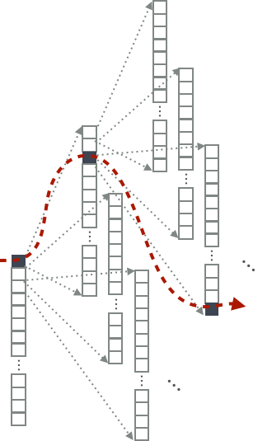
Decoding (2) – Greedy Search
Efficient, but heavily suboptimal search
Pick the most likely symbol each time
Until
Pros:
Super-efficient: both computation and memory
Cons:
Heavily suboptimal

Slide 7
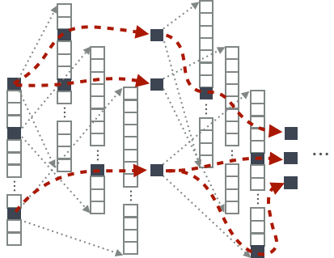
Decoding (3) – Beam Search
Pretty, but not quite efficient
Maintain K hypotheses at a time
Expand each hypothesis
Pick top-K hypotheses from the union where

Slide 8
Decoding (3) – Beam Search
Asymptotically exact, as
Not necessarily monotonic improvement w.r.t.
K is selected to maximize the translation quality on a validation set.

Slide 9
Decoding
English to Czech Translation: 12m training sentence pairs
^{Cho (2016)}

Slide 10
Inference is difficult and expensive (1)
State space grows exponentially w.r.t. the (max) length of a sentence
possible sentences with ,
No obvious way to reduce the search space: non-Markovian model
Cheap, approximate search is often too approximate
Greedy decoding: cheap, approximate search
Noisy, parallel approximate decoding (NPAD)
Beam search: expensive, approximate search
(Cho, 2016 horribly rejected from NIPS)

Slide 11
Inference is difficult and expensive (2)
Is this what we want?
Decoding objectives are not known in advance
MT for real-time conversation: quality ↑ vs. delay ↓
MT for K-12 students: quality ↑ vs. text difficulty ↓
On-device translation: quality ↑ vs. computational complexity ↓
Even if so, little or no data available
Simultaneous interpretation: almost none with time stamps [He et al., 2016 NAACL]
Parallel corpora with controlled levels of difficulty: none
What can we do about it?

Slide 12
Learning to decode

Slide 13







Neural network = Forgetting machine
Panda?
- Yes
- No
A deep neural net iteratively disentangles relevant and irrelevant features
Irrelevant features are discarded as information propagates
In other words, hidden layers contain rich info beyond the task!

Slide 14
Exploiting the hidden activation
What is captured by the hidden layers?
Deep Visualization: Edges/corners → textures → object parts → entire objects [Zeiler&Fergus, 2014 ECCV; Yosinski et al., 2016 DL; and many more]
Long-range dependency: closing brackets, agreement, … [Karpathy et al., 2015 arXiv; Tran et al., 2016 NAACL]
Sentiment! [Radford et al., 2017 OpenAI]
Fairly limited understanding especially with text
Why?
Hidden activations of a small recurrent language model

Slide 15
Trainable Decoding (1)
A conditional recurrent neural net defines an environment
State:
Previous hidden state
Current input
Source context
Action: any modification
Next input
Source
Reward: arbitrary

Slide 16
Trainable Decoding (2)
A conditional recurrent neural net defines an environment
A decoder is an agent:
Observes the state via
Acts by selecting
Limited, because it doesn’t exploit rich info captured in
Can we extend it by training a neural network decoder?

Slide 17
Yes, we can!
Simultaneous Translation
Jiatao Gu, Kyunghyun Cho, Victor OK Li. Trainable greedy decoding for neural machine translation. EMNLP 2017
Trainable Greedy Decoding
Jiatao Gu, Graham Neubig, Kyunghyun Cho, Victor OK Li. Learning to translate in real-time with neural machine translation. EACL 2017.
Yun Chen, Victor Li, Sam Bowman, Kyunghyun Cho. A Stable and Effective Learning Strategy for Trainable Greedy Decoding. (under review)

Slide 18
Simultaneous Translation (1)
Inspired by simultaneous interpretation
Source words arrive one at a time
Translation starts before the complete sentence arrives
Objective: quality ↑ delay ↓
Interpreters at the Nuremberg Trial (1945-1946)
https://www.pri.org/stories/2014-09-29/how-do-all-those-leaders-un-communicate-all-those-languages

Slide 19
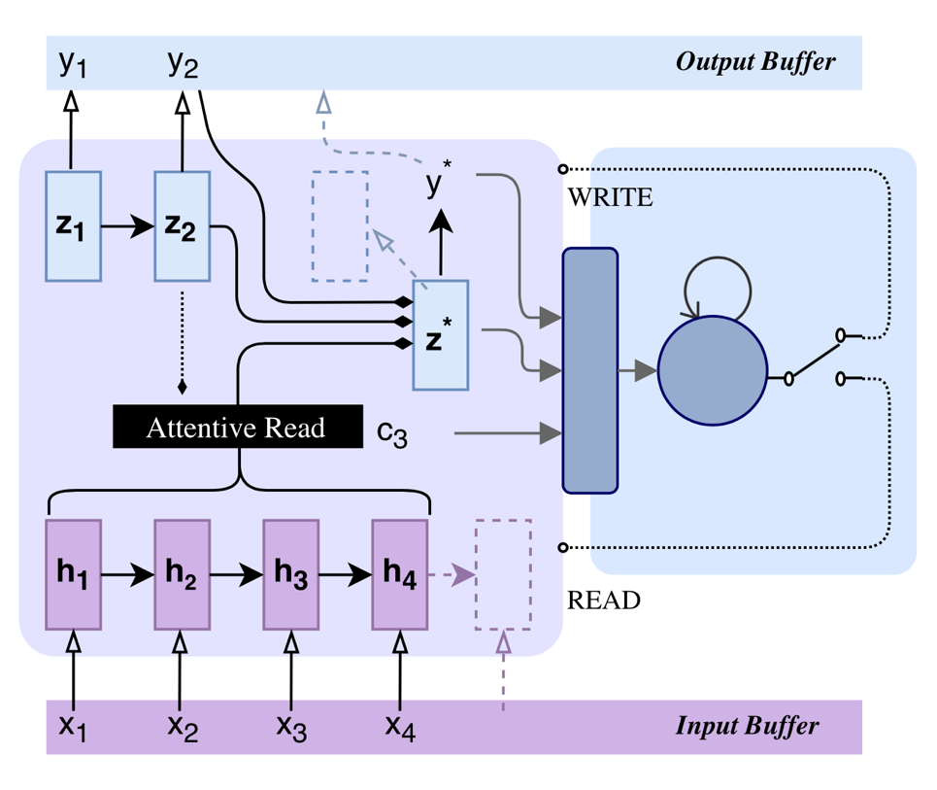
Simultaneous Translation (2)
Decoding
Start with a well-trained NMT
A simultaneous decoder intercepts and interprets the incoming signal
The simultaneous decoder forces the pretrained model to either
output a target symbol, or
wait for the next source symbol
Learning
Trade-off between delay and quality
Policy gradient (REINFORCE)
[Gu, Neubig, Cho & Li, EACL 2017]

Slide 20
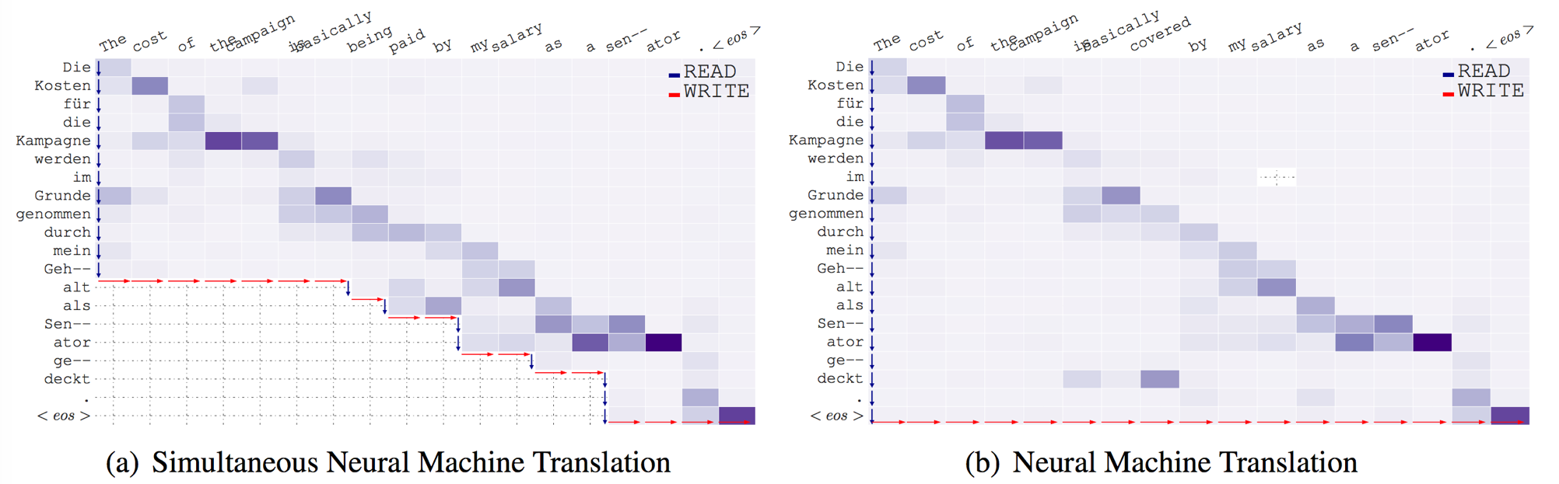
Simultaneous Translation (3)
[Gu, Neubig, Cho & Li, EACL 2017]

Slide 21
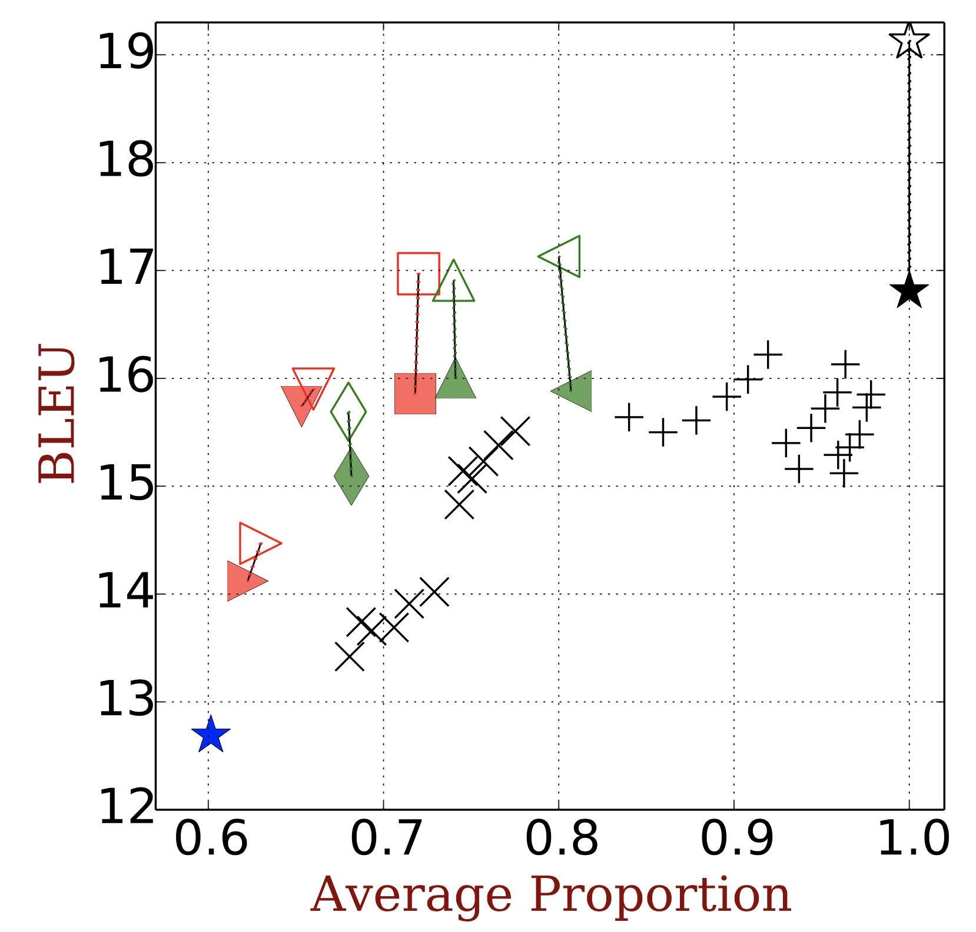
Simultaneous Translation (4)
⭑consecutive translation
⭑word-by-word translation
✚𝗫 simultaneous translation without using
◾️▲simultaneous translation (trainable decoding)
Better simultaneous translation by exploiting the rich info captured by the hidden state
Desired
[Cho & Esipova, 2016 horribly rejected from EMNLP]
[Gu, Neubig, Cho & Li, EACL 2017]

